Slide 1
How to Manage Your Medicines
A Fireside Chat With Brian Isetts, PhD, BCPS, FAPhA

Slide 2

How to Manage Your Medicines – A Fireside Chat with Brian Isetts, PhD, BCPS, FAPhA
Medicine Management Webinar
Thu, March 19, 2020 12:00 PM - 1:00 PM (CDT)
Please join my meeting from your computer, tablet
or smartphone.
https://global.gotomeeting.com/join/300664373
You can also dial in using your phone.
United States: +1 (872) 240-3311
Access Code: 300-664-373
Practical Discussion of issues like:
* How persons may personally take
charge of their medicine and organize
it for:
Ease of taking
Ease of re-ordering
Understanding the what, why, when and how's of medicines.
* How persons may obtain a little “extra” medicine to have on hand in the event of a disaster or medicine shortage due to supply interruptions
* How persons may be counseled on these topics.
This Photo by Unknown Author is licensed under CC BY-ND

Slide 3
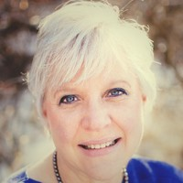
Introduction / Agenda
Open Line. Please mute yourself when not speaking!
Dr. Brian Isetts
Please be thinking of your questions. Please use our chat box to chat them in or let’s get off mute and chat later!
Lisa Morrise, Executive Director
Consumers Advancing Patient Safety

Slide 4
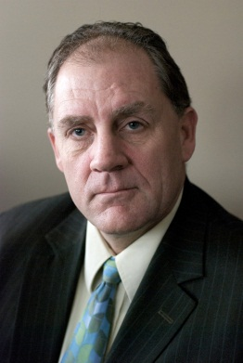
Brian J. Isetts, RPh, PhD, BCPS
Professor, University of Minnesota College of Pharmacy
Brian is a practitioner, educator and researcher. He is a former Health Policy Fellow at the Centers for Medicare & Medicaid Services. Brian has worked with the Person and Family Engagement Community over the past 7 years to design a medication use system driven by patient expectations to confidently managing their medicines.
Brian is also a Certified Living in Place Professional™ serving on the Medical Advisory Panel of the Living in Place Institute (https://www.livinginplace.institute/)

Slide 5

Let’s Start with a little Fireside Chat

Slide 6
Topics for our Chat
Practical advice for managing medicines
Tips and insights for working with doctors, nurses, pharmacists and insurance companies to help us take control of our medicines (rather than other way around)
Reducing and tapering the need for opioid medicines
Maintaining our emergency preparedness

Slide 7
Open Letter to the National Quality Forum
Dear Health Care Experts:
We request your guidance in establishing a medication use system focused on helping patients and families find the answers to three essential questions:
1) What is the intended medical use for each of my medications?
2) What are the realistic, patient-specific goals for the medications used to treat each of my conditions?
3) What are the unique safety concerns specific to my mix of conditions & medications?
We look forward to your response,
Sharon and Edward Jungbauer, Maplewood, MN (November 2012)

Slide 8
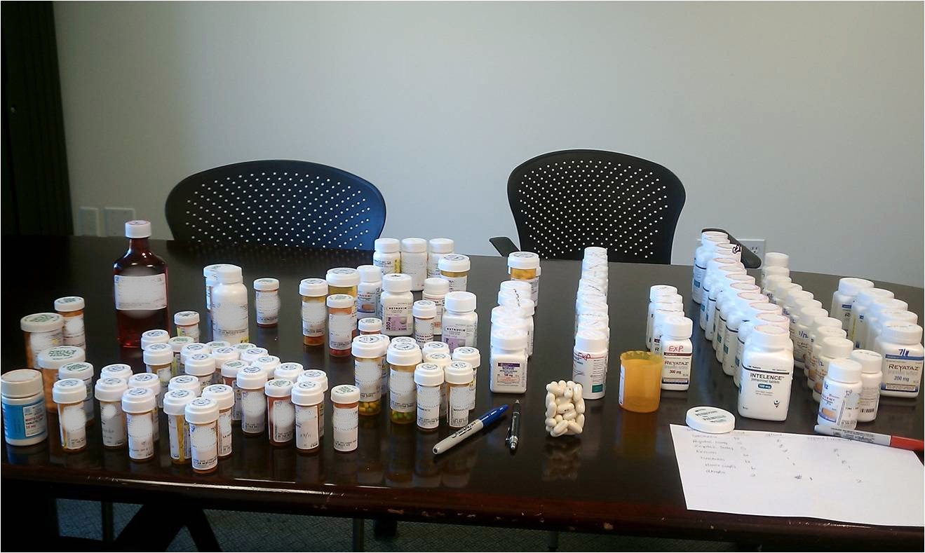
This is Reality in Far Too Many Homes
Notes:
Comprehensive medication management – Use of a consistent and systematic patient care process will guide you

Slide 9
Keys to successfully managing medicines – (from people who have done it)*
Nursing Department study of strategies used by older adults
Focus on understanding from the individual’s perspective (rather than a health provider perspective of “compliance”)
Independent living facility citizens who were confidently managing their medicines
Self-care practices can be learned over time, however there must also be an ability to care for one’s self
* Swanlund S.L., et. al. Keys to Successful Self-Management of Medications.
Nursing Science Quarterly, 2008; 21:238-246.

Slide 10
Themes for successfully managing medicines
Components/habits + living orderly + aging well
Establishing Habits–“it’s routine I do it automatically”
Adjusting Routines–“when going out I take my pills early”
Tracking–reminders/tricks to prevent “forgetfulness’
Simplifying–“clustering” to reduce unneeded complexity
Valuing Medications–viewing medicines as “essential”
Collaborating–know the why and how of each medicine
Managing Costs–getting help for financial burdens

Slide 11
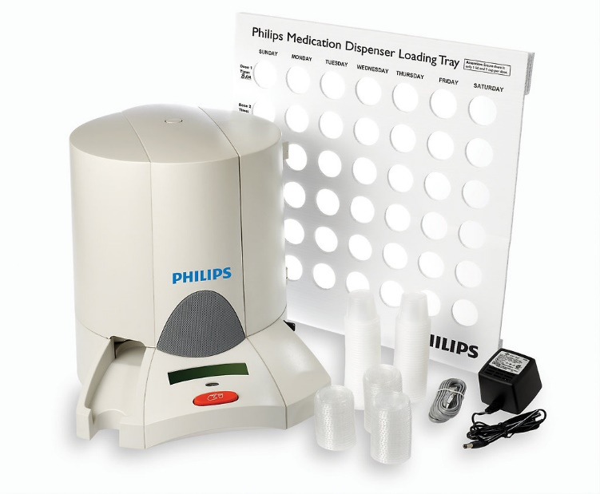
One example of an in-home medication dispensing machine*
* This is not an endorsement for any specific in-home medication dispensing system.

Slide 12
Working Effectively with Providers and Insurance Companies
Synchronized refills – one monthly pharmacy trip
A 3-month supply of medicines for chronic conditions
Requesting a “vacation supply” of medications
Shared decision-making tips – start with the intended use for each medicine, how it is supposed to work for you, and what side effects to focus on
Preventing “surprise” medical bills
Insights from Consumers Advancing Patient Safety

Slide 13
Community Strategies in Functional Status Improvement
Upstream avoidance of opioid use
Treatment access (physical & psycho-social support)
Drug disposal and diversion control
Recognizing (but not dwelling on) root causes contributing to the peak use of opioids
Promising community-wide approaches bringing us all to work together (the Iowa story)

Slide 14
Team-based Approaches to Functional Status Improvement
Upstream avoidance of opioids – a new reset point
Reframing our negative focus on pain, to a positive focus on increased comfort & activities of daily life
Evidence-based post-surgical guidelines – multi-modal & non-drug therapies first - with adjunctive opioids as a third or fourth level consideration
Document if a person is opioid naïve or tolerant
What is a “safe” level of opioid use, if you need them

Slide 15
Vigilance in times of public health crises
Hyper-sanitation and social distancing
Rational stocking of food and medical supplies
Obtaining (a little) extra supply of medicines (requesting a vacation supply)
Rethinking medication expiration dates
Medication repository initiatives
Anticipating drug shortages
Stay calm – take care of our mental well-being

Slide 16
Thank you to each and every one of you for all that you are doing to improve our health care system. When we work together, the answers are in the room.
We’re all in this together.

Slide 17
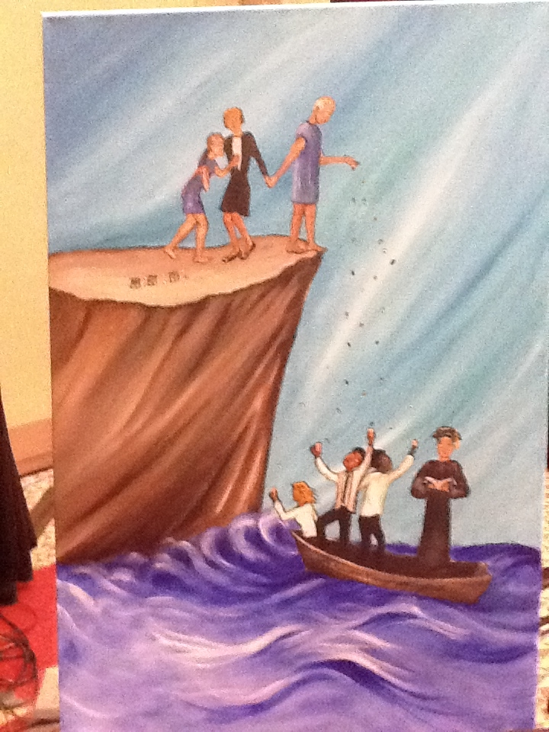

Slide 18
Discussion
E-mail: isetts@umn.edu

Slide 19
Upcoming Webinars
Speak Up! How to Speak Up and Encourage Speaking Up to Avoid Medical Harm
  Coming Soon – stay tuned!
  With presentations from Kelly Smith, PhD, Medstar Health, and

Slide 20
Join CAPS!
Sign up to get our Newsletter
www.patientsafety.org
Lisa.Morrise@gmail.com

